Slide 1
CORONA VIRUS ANALYSIS
BHAVANA T K

Slide 2
Q1. Write a code to check NULL values
select * from covid_data
WHERE Province IS NULL
OR Country_Region IS NULL
OR Latitude IS NULL
OR Longitude IS NULL
OR Date IS NULL
OR Confirmed IS NULL
OR Deaths IS NULL
OR Recovered IS NULL
Empty set

Slide 3
Q2. If NULL values are present, update them with zeros for all columns.
UPDATE covid_data
SET
Province = COALESCE(Province, 'Unknown'),
Country_Region = COALESCE(Country_Region, 'Unknown'),
Latitude = COALESCE(Latitude, 0),
Longitude = COALESCE(Longitude, 0),
Date = COALESCE(Date, '0000-00-00'),
Confirmed = COALESCE(Confirmed, 0),
Deaths = COALESCE(Deaths, 0),
Recovered = COALESCE(Recovered, 0);

Slide 4
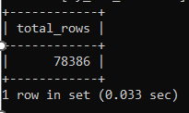
Q3. check total number of rows
SELECT COUNT(*) AS total_rows FROM covid_data;

Slide 5

Q4. Check what is start_date and end_date
SELECT MIN(Date) AS start_date, MAX(Date) AS end_date FROM covid_data;

Slide 6
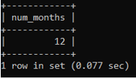
Q5. Number of month present in dataset
SELECT COUNT(DISTINCT MONTH(Date)) AS num_months FROM covid_data;

Slide 7
Q6. Find monthly average for confirmed, deaths, recovered
SELECT
YEAR(Date) AS Year,
MONTH(Date) AS Month,
AVG(Confirmed) AS Avg_Confirmed,
AVG(Deaths) AS Avg_Deaths,
AVG(Recovered) AS Avg_Recovered
FROM
covid_data
GROUP BY
Year, Month
ORDER BY
Year, Month;

Slide 8
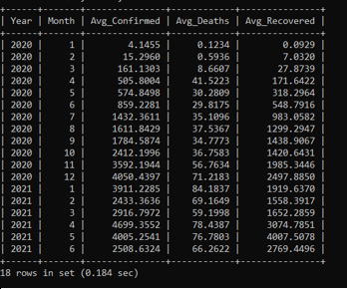

Slide 9
Q7. Find most frequent value for confirmed, deaths, recovered each month
select
month(date)as month,
year(date)as year,
substring_index(group_concat(confirmed order by confirmed desc),',',1) as most_frequent_confirmed,
substring_index(group_concat(deaths order by deaths desc),',',1) as most_frequent_deaths,
substring_index(group_concat(recovered order by recovered desc),',',1) as most_frequent_recovered
from covid_data
group by
year(date),month(date)
order by
year(date),month(date);

Slide 10
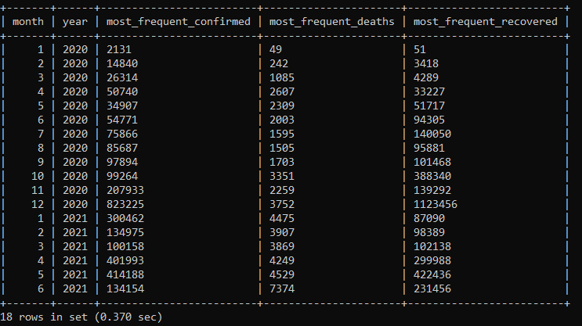

Slide 11
Q8. Find minimum values for confirmed, deaths, recovered per year
SELECT
YEAR(Date) AS Year,
MIN(Confirmed) AS Min_Confirmed,
MIN(Deaths) AS Min_Deaths,
MIN(Recovered) AS Min_Recovered
FROM
covid_data
GROUP BY
Year;

Slide 12
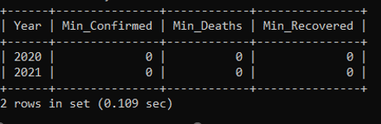

Slide 13
Q9. Find maximum values of confirmed, deaths, recovered per year
SELECT
YEAR(Date) AS Year,
MAX(Confirmed) AS Max_Confirmed,
MAX(Deaths) AS Max_Deaths,
MAX(Recovered) AS Max_Recovered
FROM
covid_data
GROUP BY
Year;

Slide 14
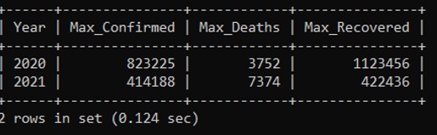

Slide 15
Q10. The total number of case of confirmed, deaths, recovered each month
SELECT
YEAR(Date) AS Year,
MONTH(Date) AS Month,
SUM(Confirmed) AS Total_Confirmed,
SUM(Deaths) AS Total_Deaths,
SUM(Recovered) AS Total_Recovered
FROM
covid_data
GROUP BY
Year, Month
ORDER BY
Year, Month;

Slide 16
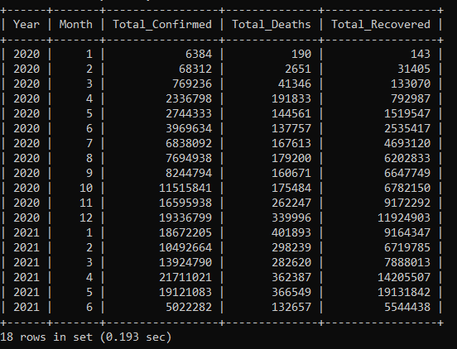

Slide 17
Q11. Check how corona virus spread out with respect to confirmed case (Eg.: total confirmed cases, their average, variance & STDEV )
SELECT
SUM(confirmed) AS total_confirmed_cases,
AVG(confirmed) AS avg_confirmed_cases,
VARIANCE(confirmed) AS var_confirmed_cases,
STDDEV(confirmed) AS std_confirmed_cases
FROM
covid_data;

Slide 18
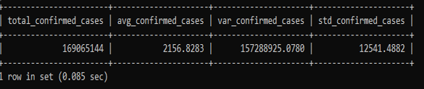

Slide 19
Q12. Check how corona virus spread out with respect to death case per month(Eg.: total confirmed cases, their average, variance & STDEV )
SELECT
YEAR(Date) AS Year,
MONTH(Date) AS Month,
SUM(Deaths) AS Total_Death_Cases,
AVG(Deaths) AS Average_Death_Cases,
VARIANCE(Deaths) AS Variance_Death_Cases,
STDDEV(Deaths) AS StdDev_Death_Cases
FROM
covid_data
GROUP BY
Year, Month
ORDER BY
Year, Month;

Slide 20
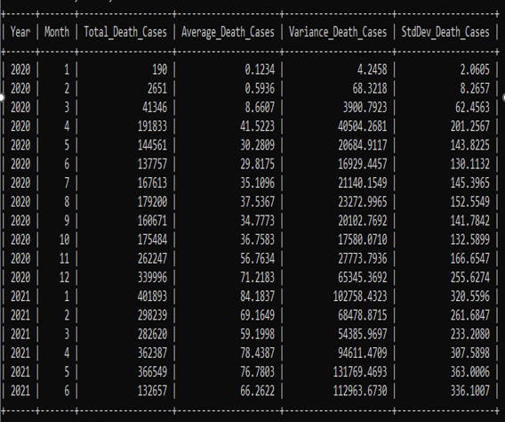

Slide 21
Q13. Check how corona virus spread out with respect to recovered case(Eg.: total confirmed cases, their average, variance & STDEV )
select
SUM(Recovered) AS Total_Recovered_Cases,
AVG(Recovered) AS Average_Recovered_Cases,
VARIANCE(Recovered) AS Variance_Recovered_Cases,
STDDEV(Recovered) AS StdDev_Recovered_Cases
FROM
covid_data;

Slide 22


Slide 23
Q14. Find Country having highest number of the Confirmed case
SELECT
Country_Region,
SUM(Confirmed) AS Total_Confirmed_Cases
FROM
covid_data
GROUP BY
Country_Region
ORDER BY
Total_Confirmed_Cases DESC
LIMIT 1;

Slide 24


Slide 25
Q15. Find Country having lowest number of the death case
SELECT
Country_Region,
SUM(Deaths) AS Total_Death_Cases
FROM
covid_data
GROUP BY
Country_Region
ORDER BY
Total_Death_Cases
LIMIT 4;

Slide 26
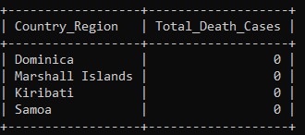

Slide 27
Q16. Find top 5 countries having highest recovered case
SELECT
Country_Region,
SUM(Recovered) AS Total_Recovered_Cases
FROM
covid_data
GROUP BY
Country_Region
ORDER BY
Total_Recovered_Cases
DESC
LIMIT 5;

Slide 28
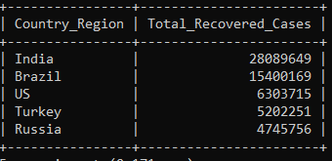

Slide 29
THANK YOU

